Slide 1

Module 2
Mathematics Foundations of Cryptography
Part I: Divisibility, Euclidean Algorithm, Modular Arithmetic, Congruence,
Copyright © The McGraw-Hill Companies, Inc. Permission required for reproduction or display.

Slide 2
Objectives – Part 1
To review integer arithmetic, concentrating on divisibility and finding the greatest common divisor using the Euclidean algorithm
To emphasize the importance of modular arithmetic and the modulo
operator, because they are extensively used in cryptography
Explain operation of the extended Euclidean Algorithm
Discuss Key concepts relating to prime numbers
Understand Fermat’s Theorem, Euler’s Theorem, Euler’s Totient
function, Chinese Reminder Theorem
Pre-requisite for Asymmetric Key Cryptography
Algebraic Structures – Group, Ring, Field
Primes
Factorization
Exponentiation
Discrete Logarithm

Slide 3
Number Theory
Number Theory, a branch of mathematics concerned with the properties of integers ; is pervasive in cryptographic algorithms
Relevant number theory topics for understanding the wide range of applications in cryptography
In order to understand how modern cryptographic techniques work, and to estimate the extent to which they are secure, it is important to understand the basics of number theory.

Slide 4
2-1 INTEGER ARITHMETIC
In integer arithmetic, we use a set and a few operations. You are familiar with this set and the corresponding operations, but they are reviewed here to create a background for modular arithmetic.
Topics discussed in this section:
2.1.1 Set of Integers 2.1.2 Binary Operations 2.1.3 Integer Division
2.1.4 Divisibility
2.1.5 Linear Diophantine Equations

Slide 5

2.1.1 Set of Integers
The set of integers, denoted by Z, contains all integral numbers (with no fraction) from negative infinity to positive infinity (Figure 2.1).
Figure 2.1 The set of integers

Slide 6
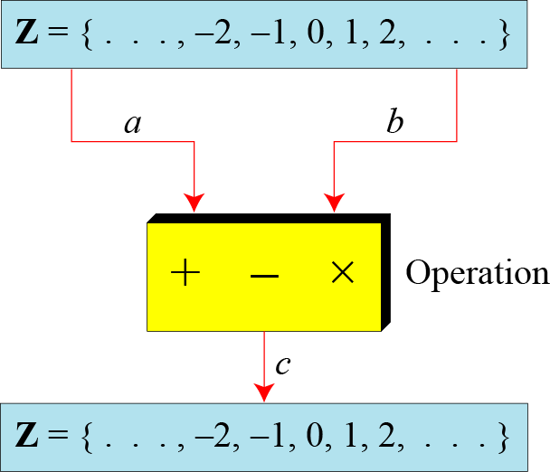
2.1.2 Binary Operations
In cryptography, we are interested in three binary operations applied to the set of integers. A binary operation takes two inputs and creates one output.
Figure 2.2 Three binary operations for the set of integers

Slide 7
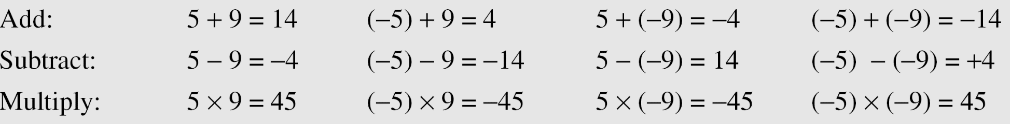
2.1.2 Continued
Example 2.1
The following shows the results of the three binary operations on two integers. Because each input can be either positive or negative, we can have four cases for each operation.

Slide 8
2.1.3 Integer Division
In integer arithmetic, if we divide a by n, we can get q
And r . The relationship between these four integers can be shown as
a = q × n + r

Slide 9
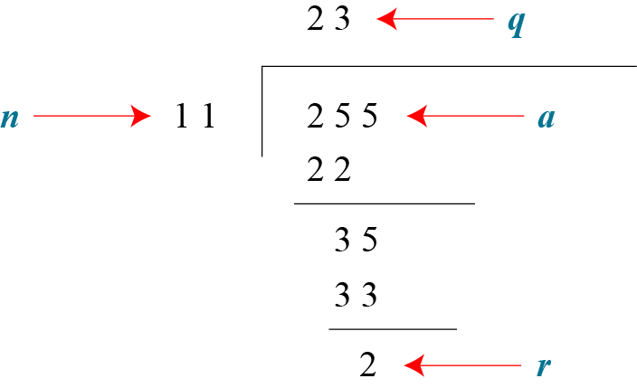
2.1.3 Continued
Example 2.2
Assume that a = 255 and n = 11. We can find q = 23 and R = 2 using the division algorithm.
Figure 2.3 Example 2.2, finding the quotient and the remainder

Slide 10
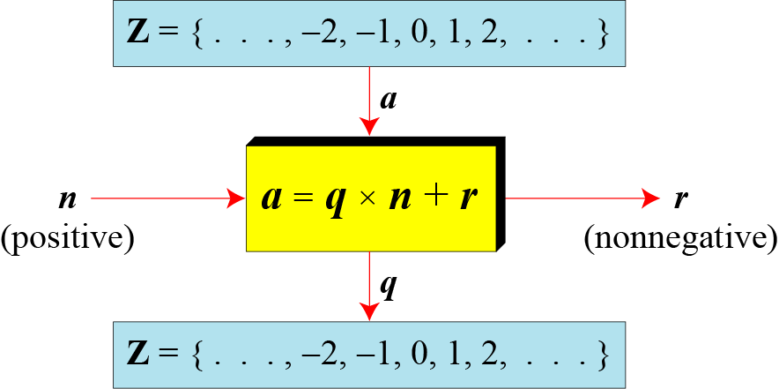
2.1.3 Continued
Figure 2.4 Division algorithm for integers

Slide 11
2.1.3 Continued
Example 2.3
When we use a computer or a calculator, r and q are negative when a is negative. How can we apply the restriction that r needs to be positive?
The solution is simple, we decrement the value of q by 1 and
we add the value of n to r to make it positive.

Slide 12
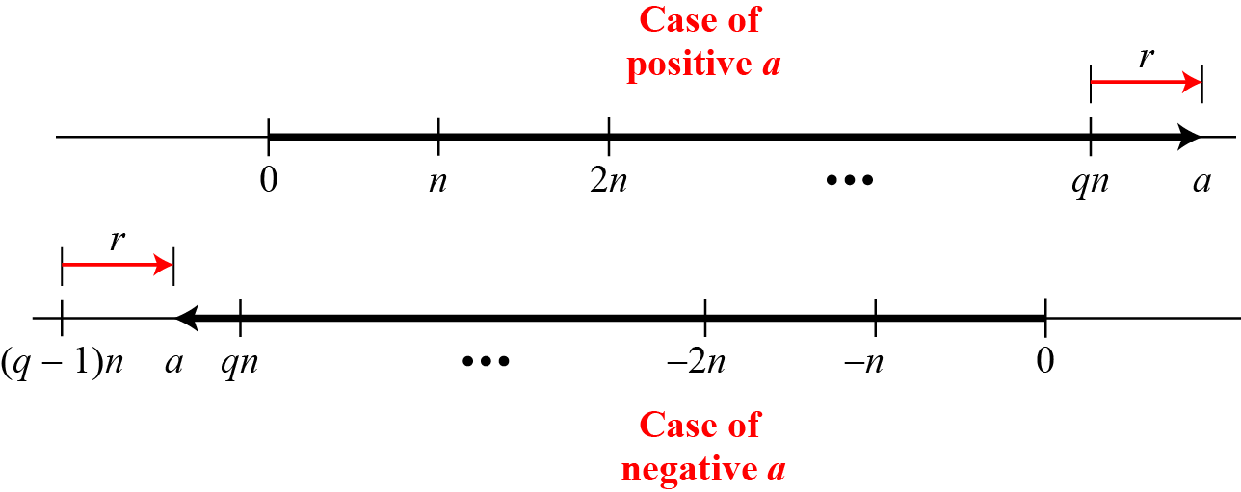
2.1.3 Continued
Figure 2.5 Graph of division alogorithm
Starting from zero, the graph shows how we can reach the point representing the integer a on the line, In case of positive a, we move q*n units to the right and then move extra r units in the same direction.
, In case of negative a, we need to move (q-1)*n units to the left (q is negative) and then move r units in the opposite direction. Both cases r is positive

Slide 13
Divisibility and Divisors
We say that m divides n (or n is divisible by m) if:
m > 0
and:
the ratio is an integer.
This property underlies all number theory, so we have a notation for it:
and we say that m is a divisor of n

Slide 14
2.1.4 Divisbility
If the remainder is zero,
Notation – means a divides n
If the remainder is not zero,

Slide 15
2.1.4 Continued
Example 2.4
The integer 4 divides the integer 32 because 32 = 8 × 4. We show this as
b. The number 8 does not divide the number 42 because
42 = 5 × 8 + 2. There is a remainder, the number 2, in the equation. We show this as

Slide 16
2.1.4 Continued
Properties
Property 1: if a|1, then a = ±1.
Property 2: if a|b and b|a, then a = ±b.
Property 3: if a|b and b|c, then a|c.
Property 4: if a|b and a|c, then a|(m × b + n × c), where m and n are arbitrary integers

Slide 17
2.1.4 Continued
Example 2.5

Slide 18
2.1.4 Continued
Example 2.6

Slide 19

2.1.4 Continued
Note
Fact 1: The integer 1 has only one divisor, itself.
Fact 2: Any positive integer has at least
two divisors, 1 and itself (but it can have more).

Slide 20
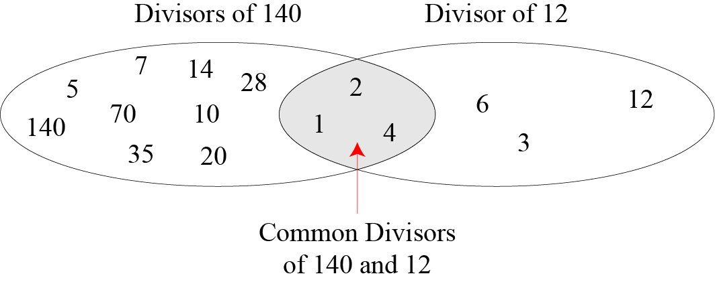
2.1.4 Continued
Figure 2.6 Common divisors of two integers

Slide 21
2.1.4 Continued
Note
Greatest Common Divisor
The greatest common divisor of two positive integers is the largest integer that can divide both integers.
Note
Euclidean Algorithm
Fact 1: gcd (a, 0) = a Fact 2: gcd (a, b) = gcd (b, r), where r is the remainder of dividing a by b
Fact 2 allow us to change the value of a, b until b becomes 0

Slide 22
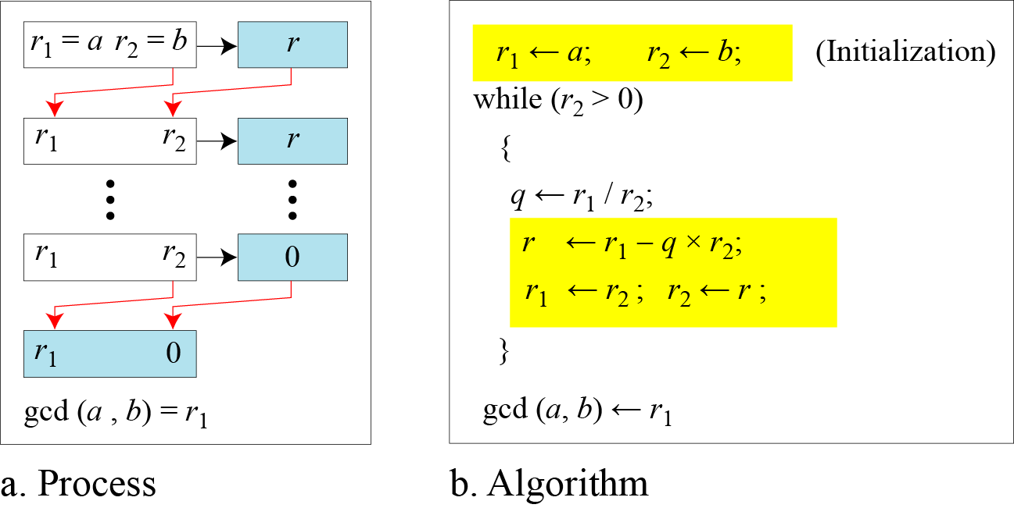
2.1.4 Continued
Figure 2.7 Euclidean Algorithm
Note
gcd (36,10) =
When gcd (a, b) = 1, we say that a and b are relatively prime.

Slide 23
2.1.4 Continued
Note
When gcd (a, b) = 1, we say that a and b are relatively prime.

Slide 24
2.1.4 Continued
Example 2.7
Find the greatest common divisor of 2740 and 1760.
Solution
We have gcd (2740, 1760) = ?.

Slide 25
2.1.4 Continued
Example 2.7
Find the greatest common divisor of 2740 and 1760.
Solution
We have gcd (2740, 1760) = 20.

Slide 26
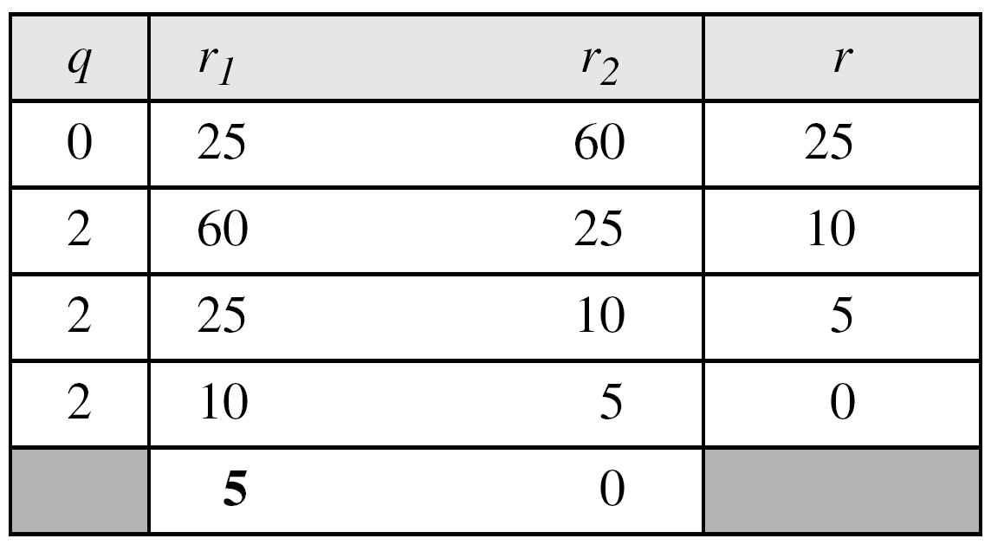
2.1.4 Continued
Example 2.8
Find the greatest common divisor of 25 and 60.
Solution
We have gcd (25, 65) = 5.

Slide 27

2.1.4 Continued
Extended Euclidean Algorithm
Given two integers a and b, we often need to find other two integers, s and t, such that
The extended Euclidean algorithm can calculate the gcd (a, b) and at the same time calculate the value of s and t.

Slide 28
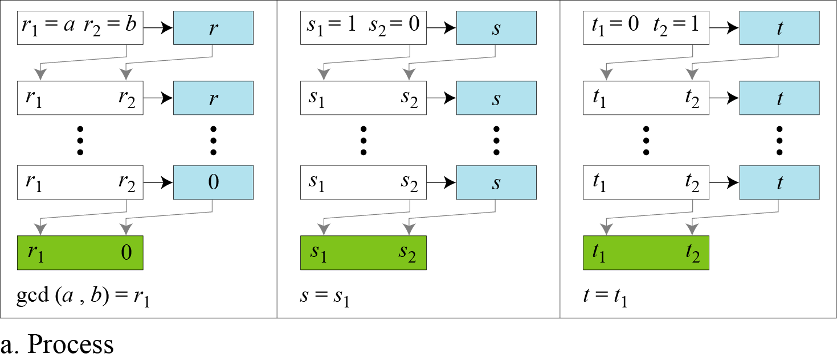
2.1.4 Continued
Figure 2.8.a Extended Euclidean algorithm, part a
There is only one quotient q, which is calculated as r1/r2 and used for other two calculations.

Slide 29
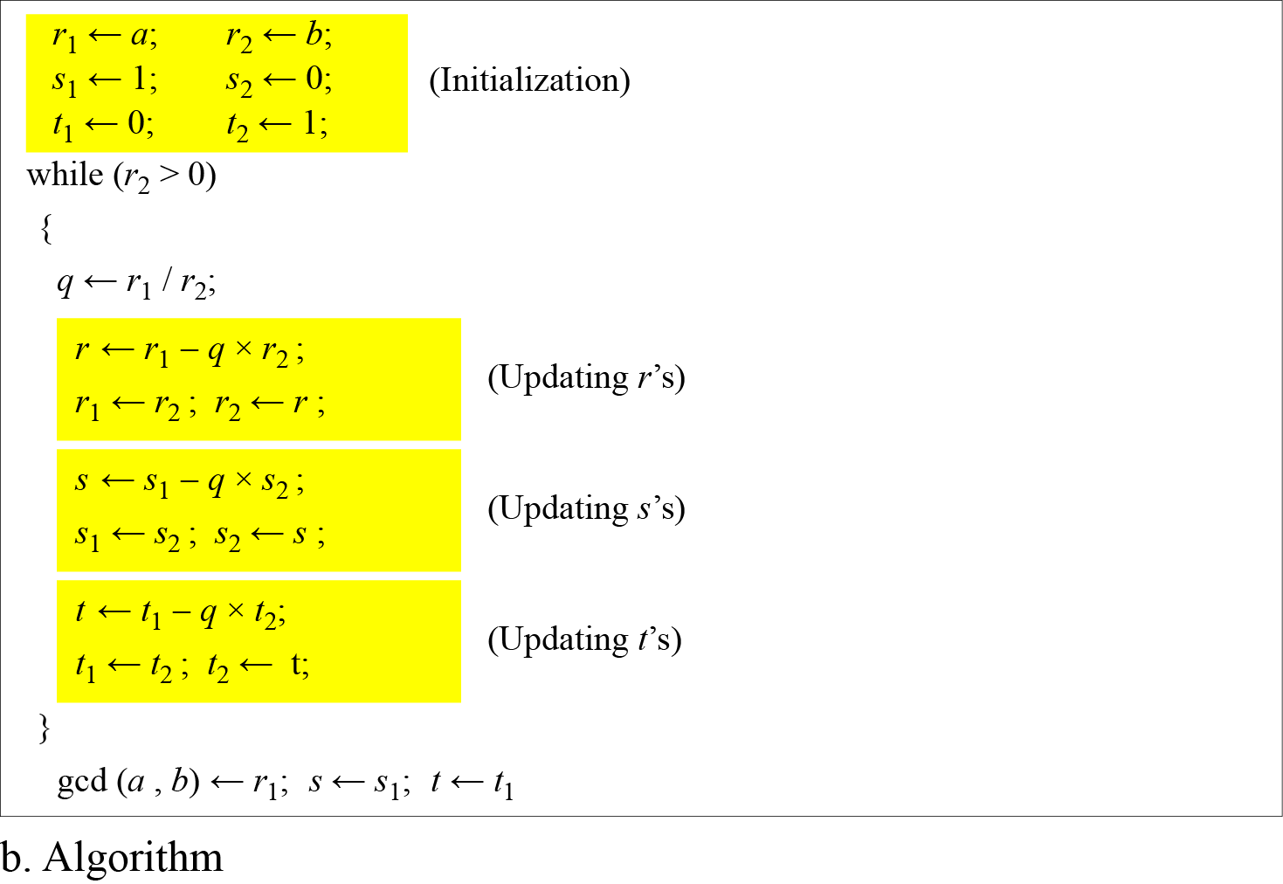
2.1.4 Continued
Figure 2.8.b Extended Euclidean algorithm, part b

Slide 30
2.1.4 Continued
Example 2.9
Given a = 161 and b = 28, find gcd (a, b) and the values of s and t.
Solution
We get gcd (161, 28) = ?

Slide 31
2.1.4 Continued
Example 2.9
Given a = 161 and b = 28, find gcd (a, b) and the values of s and t.
Solution
We get gcd (161, 28) = 7, s = −1 and t = 6.

Slide 32
2.1.4 Continued
Example 2.10
Given a = 17 and b = 0, find gcd (a, b) and the values of s and t.
Solution
We get gcd (17, 0) = 17, s = 1, and t = 0.

Slide 33
2.1.4 Continued
Example 2.11
Given a = 0 and b = 45, find gcd (a, b) and the values of s and t.
Solution
We get gcd (0, 45) = 45, s = 0, and t = 1.

Slide 34
2-2 MODULAR ARITHMETIC
The division relationship (a = q × n + r) discussed in the previous section has two inputs (a and n) and two outputs (q and r). In modular arithmetic, we are interested in only one of the outputs, the remainder r.
Topics discussed in this section:
2.2.1 Modular Operator 2.2.2 Set of Residues 2.2.3 Congruence 2.2.4 Operations in Z_{n}
2.2.5 Addition and Multiplication Tables
2.2.6 Different Sets

Slide 35
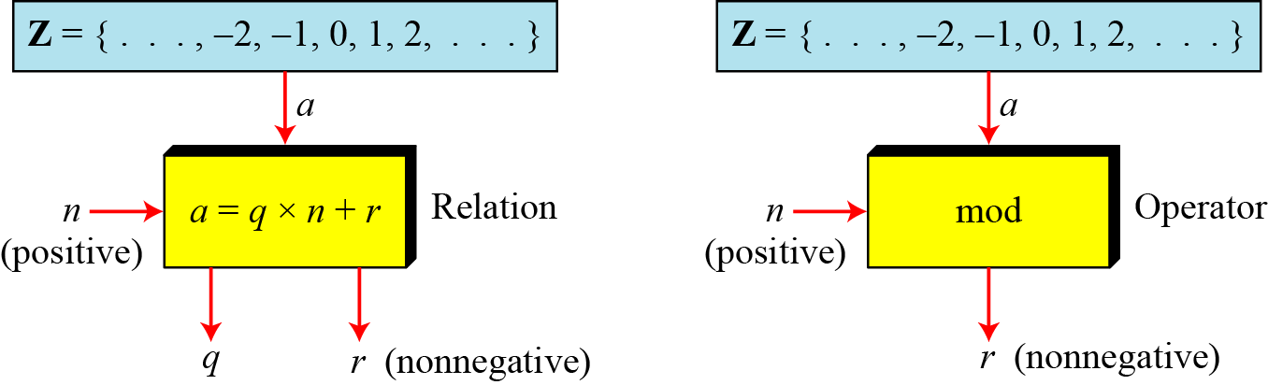
2.2.1 Modulo Operator
The modulo operator is shown as mod. The second input (n) is called the modulus. The output r is called the residue.
Figure 2.9 Division algorithm and modulo operator

Slide 36
2.1.4 Continued
Example 2.14
Find the result of the following operations:
a. 27 mod 5 b. 36 mod 12
c. −18 mod 14 d. −7 mod 10
Solution
Dividing 27 by 5 results in r = 2
Dividing 36 by 12 results in r = 0.
c. Dividing −18 by 14 results in r = −4. After adding the modulus r = 10
d. Dividing −7 by 10 results in r = −7. After adding the modulus to −7, r = 3.

Slide 37
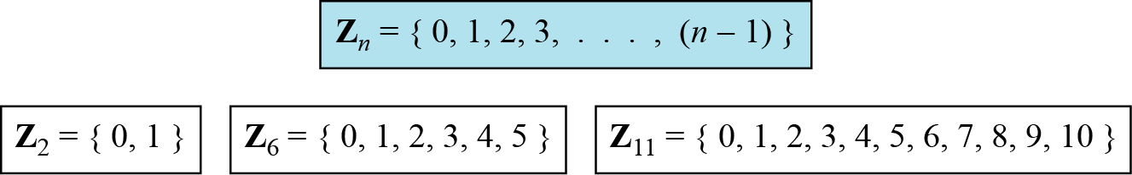
2.2.2 Set of Residues
The modulo operation creates a set, which in modular arithmetic is referred to as the set of least residues modulo n, or Z_{n}.
Figure 2.10 Some Z_{n} sets

Slide 38
2.2.3 Congruence
In cryptography, often use concept of congruence instead of equality. Mapping from Z to Zn is not one to one
Infinite members of Z can map to one member of Zn. Ex: result of 2 mod 10 = 12 mod 10 = 22 mod 10 = 2 & so on.
To show that two integers are congruent, we use the congruence operator ( ≡ ). For example, we write:

Slide 39
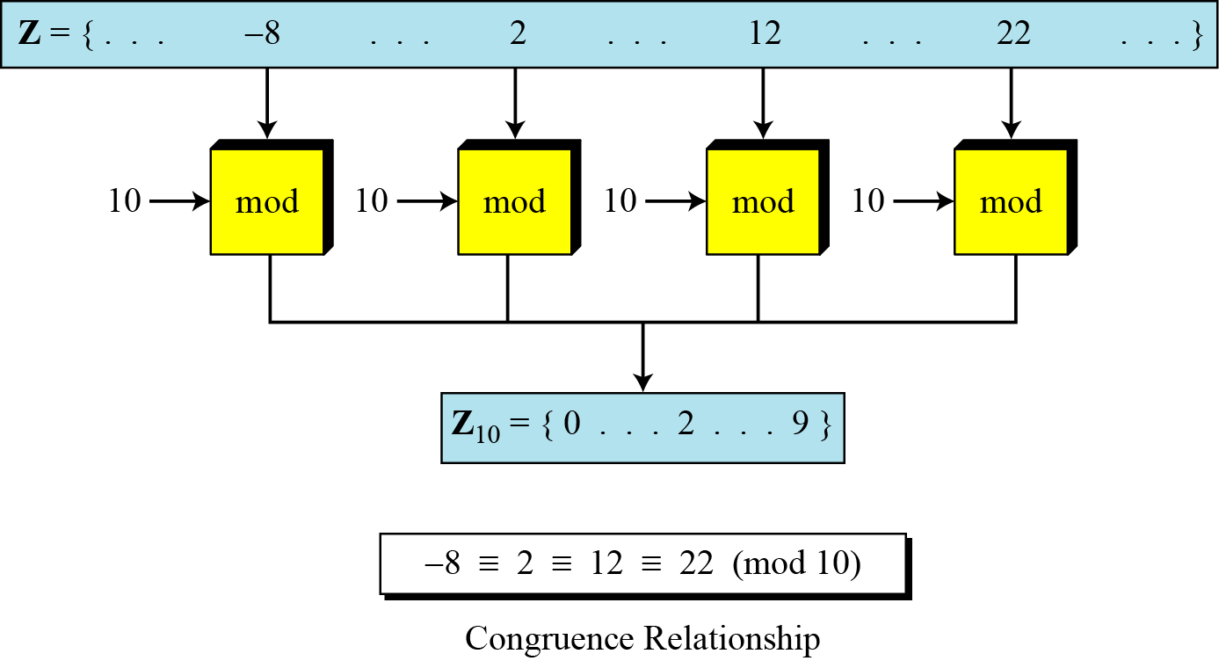
2.2.3 Continued
Figure 2.11 Concept of congruence

Slide 40
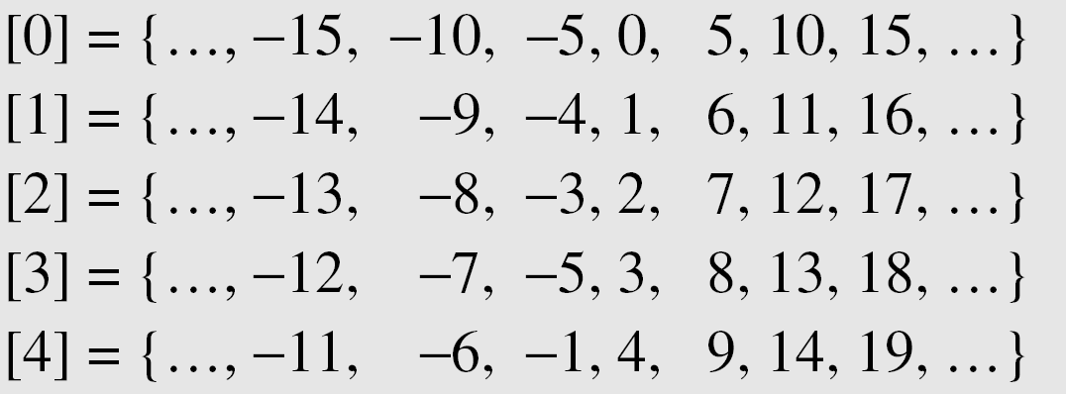
2.2.3 Continued
Residue Classes
A residue class [a] or [a]_{n} is the set of integers congruent modulo n.
Set of all integers such that x = a (mod n) .
If n=5, we have five sets [0],[1],[2],[3],[4].
Integers in set [0] are all reduced to 0 when we apply modulo 5 operation, and so on.

Slide 41
Set of Least residue modulo n
In each set, there is one element called the least (non-negative) residue.
Set of all of these least residue is what we Z₅ ₌ {0,1,2,3,4}

Slide 42
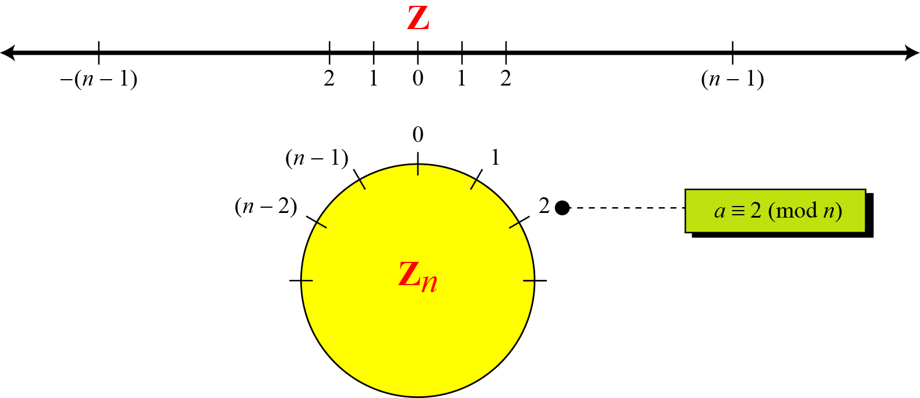
2.2.3 Continued
Figure 2.12 Comparison of Z and Z_{n} using graphs
All congruent integers modulo n occupy same point on the circle
Concept of congruence can be better understood with use of circle.
Line – shows distribution of integers in Z, similarly circle for Zn

Slide 43
2.2.3 Continued
Example 2.15
We use modular arithmetic in our daily life; for example, we use a clock to measure time. Our clock system uses modulo 12 arithmetic. However, instead of a 0 we use the number 12.

Slide 44
2.2.5 Inverses
When we are working in modular arithmetic, we often need to find the inverse of a number relative to an operation. We are normally looking for an additive inverse (relative to an addition operation) or a multiplicative inverse (relative to a multiplication operation).

Slide 45

2.2.5 Continue
Additive Inverse
In Z_{n}, two numbers a and b are additive inverses of each other if
Note
In modular arithmetic, each integer has an additive inverse. The sum of an integer and its additive inverse is congruent to 0 modulo n.

Slide 46
2.2.5 Continued
Example 2.21
Find all additive inverse pairs in Z10.
Solution
The six pairs of additive inverses are (0, 0), (1, 9), (2, 8), (3, 7), (4, 6), and (5, 5).

Slide 47

2.2.5 Continue
Multiplicative Inverse
In Z_{n}, two numbers a and b are the multiplicative inverse of each other if
Note
In modular arithmetic, an integer may or may not have a multiplicative inverse.
When it does, the product of the integer and its multiplicative inverse is congruent to 1 modulo n.

Slide 48
2.2.5 Continued
Example 2.22
Find the multiplicative inverse of 8 in Z₁₀.
Solution
There is no multiplicative inverse because gcd (10, 8) = 2 ≠ 1. In other words, we cannot find any number between 0 and 9 such that when multiplied by 8, the result is congruent to 1.
Example 2.23
Find all multiplicative inverses in Z₁₀.
Solution
There are only three pairs: (1, 1), (3, 7) and (9, 9). The numbers 0, 2, 4, 5, 6, and 8 do not have a multiplicative inverse.

Slide 49
2.2.5 Continued
Example 2.24
Find all multiplicative inverse pairs in Z₁₁.
Solution
We have seven pairs: (1, 1), (2, 6), (3, 4), (5, 9), (7, 8), (9, 9), and (10, 10).

Slide 50
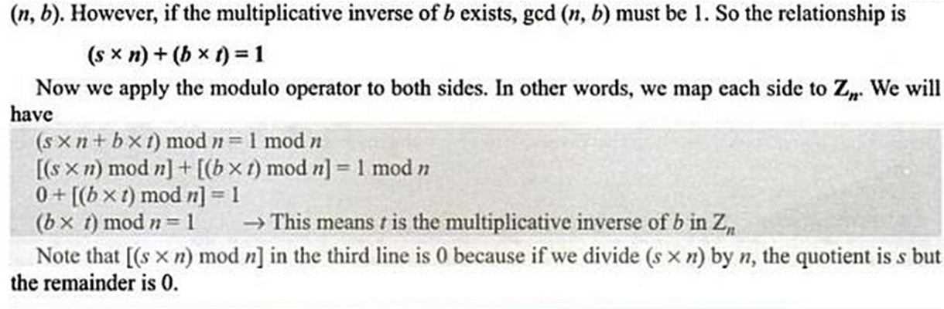

Slide 51
2.2.5 Continued
Note
The extended Euclidean algorithm finds the multiplicative inverses of b in Z_{n} when n and b are given and
gcd (n, b) = 1.
The multiplicative inverse of b is the value of t after being mapped to Z_{n}.

Slide 52
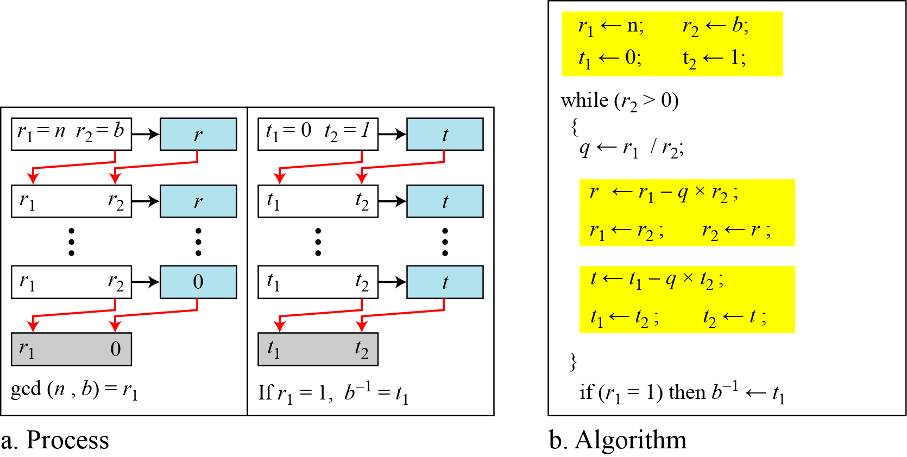
2.2.5 Continued
Figure 2.15 Using extended Euclidean algorithm to find multiplicative inverse

Slide 53
2.2.5 Continued
Example 2.25
Find the multiplicative inverse of 11 in Z₂₆.
Solution

Slide 54
2.2.5 Continued
Example 2.25
Find the multiplicative inverse of 11 in Z₂₆.
Solution
The gcd (26, 11) is 1; the inverse of 11 is −7 or 19.

Slide 55
2.2.5 Continued
Example 2.26
Find the multiplicative inverse of 23 in Z₁₀₀.
Solution
The gcd (100, 23) is 1; the inverse of 23 is −13 or 87.

Slide 56
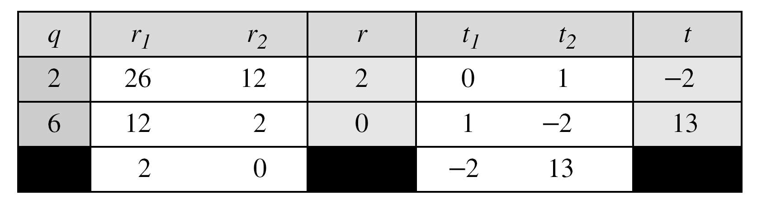
2.2.5 Continued
Example 2.27
Find the inverse of 12 in Z₂₆.
Solution
The gcd (26, 12) is 2; the inverse does not exist.

Slide 57
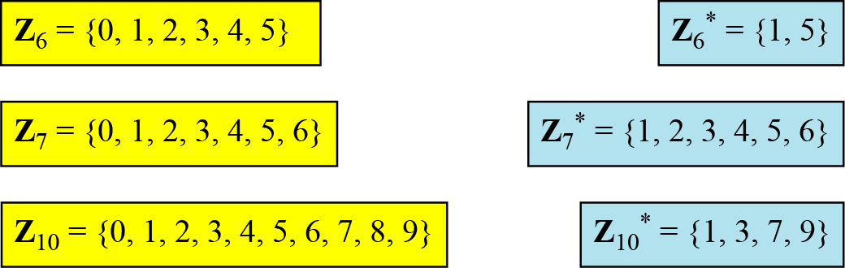
2.2.7 Different Sets
Figure 2.17 Some Z_{n} and Z_{n}* sets
Note
We need to use Zn when additive inverses are needed; we need to use Zn* when multiplicative inverses are needed.

Slide 58
2.2.8 Two More Sets
Cryptography often uses two more sets: Z_{p} and Z_{p}*. The modulus in these two sets is a prime number.

Slide 59
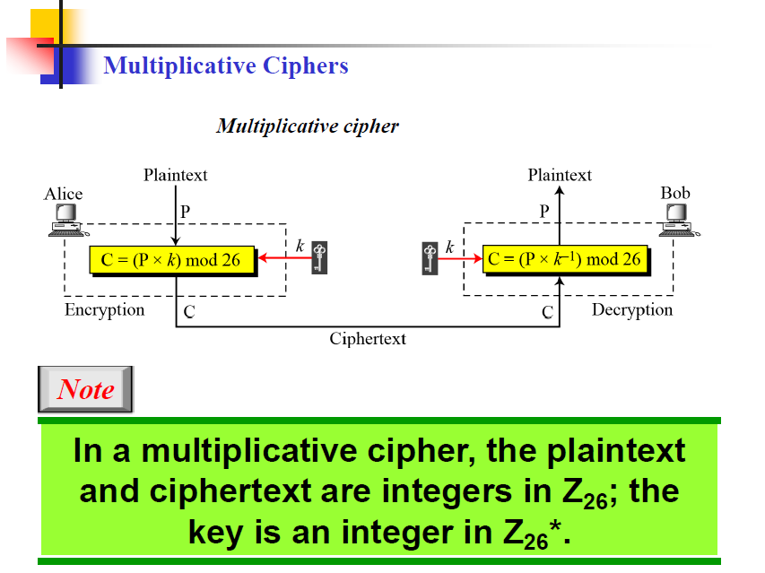

Slide 60
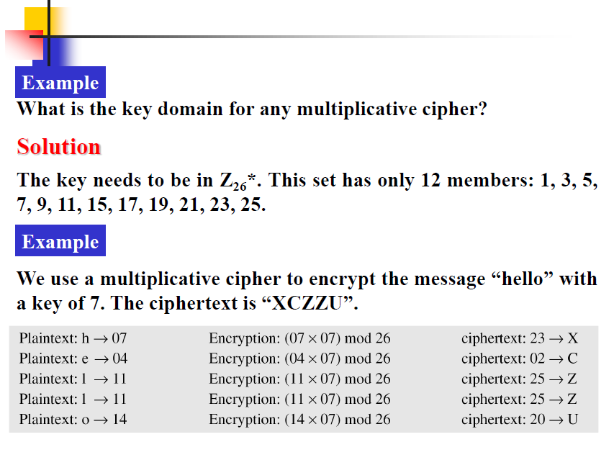

Slide 61
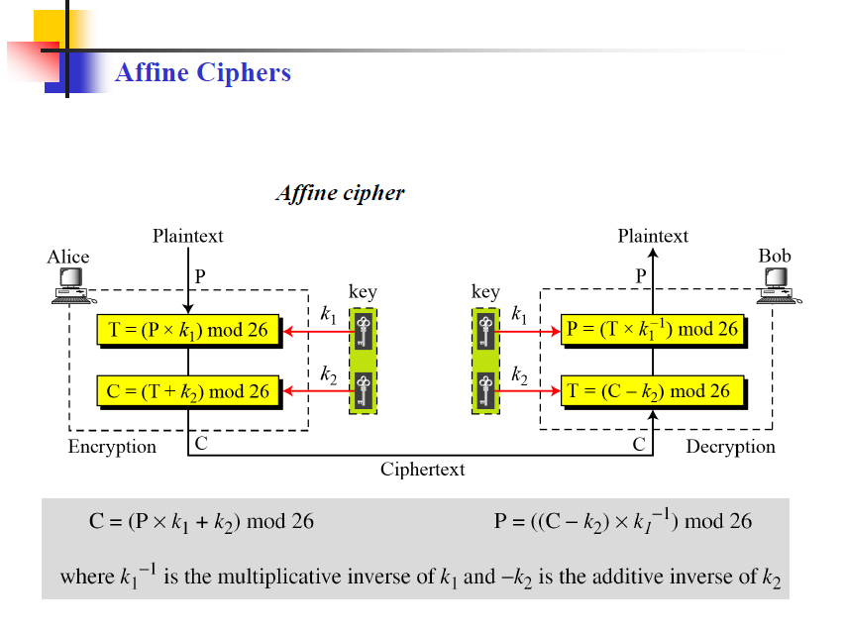

Slide 62
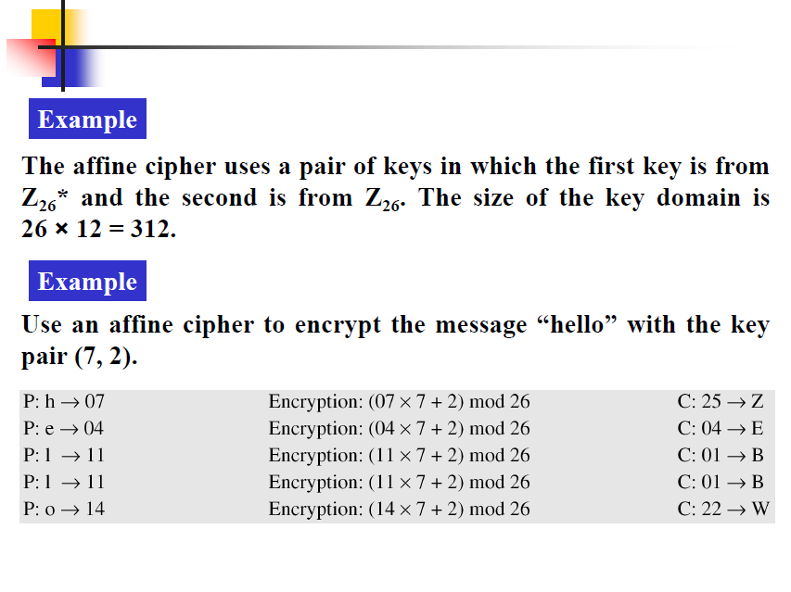

Slide 63
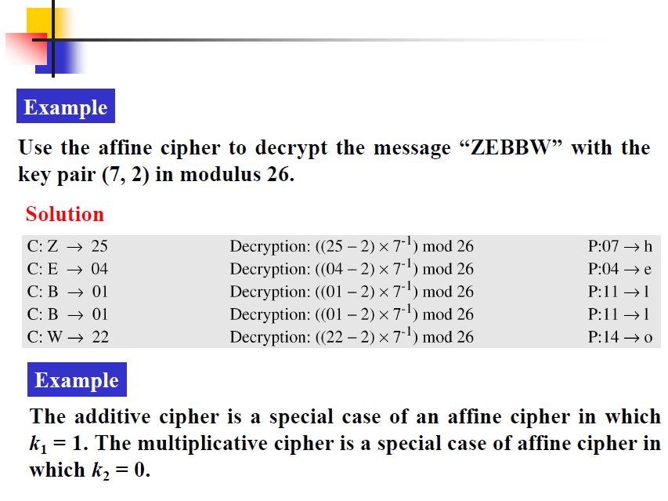

Slide 64
Objectives
❏ To introduce prime numbers and their applications in cryptography.
❏ To discuss factorization algorithms and their applications in cryptography.
❏ To describe the Chinese remainder theorem and its application.
❏ To introduce modular exponentiation and logarithm.

Slide 65
9-1 PRIMES
Asymmetric-key cryptography uses primes extensively. The topic of primes is a large part of any book on number theory.
Topics discussed in this section:
9.1.1 Definition
9.1.2 Cardinality of Primes
9.1.3 Checking for Primeness
9.1.4 Euler’s Phi-Function
9.1.5 Fermat’s Little Theorem
9.1.6 Euler’s Theorem
9.1.7 Generating Primes

Slide 66
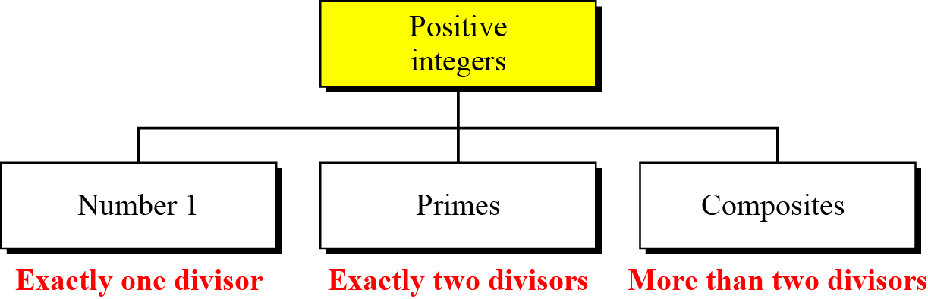
9.1.1 Definition
Figure 9.1 Three groups of positive integers
Note
A prime is divisible only by itself and 1.

Slide 67
9.1.1 Continued
Example 9.1
What is the smallest prime?
Solution
The smallest prime is 2, which is divisible by 2 (itself) and 1.
Example 9.2
List the primes smaller than 10.
Solution
There are four primes less than 10: 2, 3, 5, and 7. It is interesting to note that the percentage of primes in the range 1 to 10 is 40%. The percentage decreases as the range increases.

Slide 68
9.1.2 Cardinality of Primes
Infinite Number of Primes
Note
There is an infinite number of primes.

Slide 69
9.1.2 Continued
Number of Primes
Find the number of primes less than 1,000,000.
Solution
The approximation gives the range 72,383 to 78,543. The actual number of primes is 78,498.

Slide 70

9.1.3 Checking for Primeness
Given a number n, how can we determine if n is a prime? The answer is that we need to see if the number is divisible by all primes less than
We know that this method is inefficient, but it is a good start.

Slide 71
9.1.3 Continued
Example 9.5
Is 97 a prime?
Solution
The floor of √97 = 9. The primes less than 9 are 2, 3, 5, and 7. We need to see if 97 is divisible by any of these numbers. It is not, so 97 is a prime.
Example 9.6
Is 301 a prime?
Solution
The floor of √301 = 17. We need to check 2, 3, 5, 7, 11, 13, and 17. The numbers 2, 3, and 5 do not divide 301, but 7 does. Therefore 301 is not a prime.

Slide 72
9.1.4 Euler’s Phi-Function
Euler’s phi-function, φ (n), which is sometimes called the
Euler’s totient function plays a very important role in cryptography.

Slide 73
9.1.4 Continued
We can combine the above four rules to find the value of φ(n). For example, if n can be factored as
n = p₁^{e1} × p₂^{e2} × … × p_{k}^{ek}
then we combine the third and the fourth rule to find
Note
The difficulty of finding φ(n) depends on the difficulty of finding the factorization of n.

Slide 74
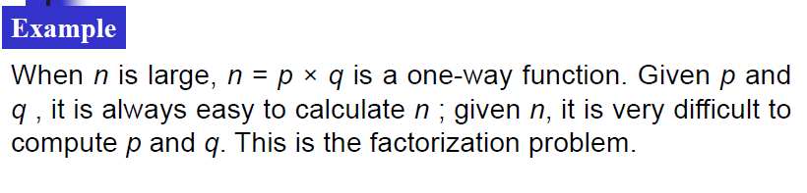
One-way Function
Satisfies two properties
f is easy to compute. Given x, y=f(x) can be easily computed
f⁻¹ is difficult to compute. Given y, it is computationally infeasible to calculate x= f⁻¹(y)
Trapdoor One-way function
3rd property
Given y and a trapdoor (secret), x can be computed easily.

Slide 75
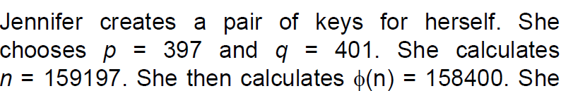

Slide 76
9.1.4 Continued
Example 9.7
What is the value of φ(13)?
Solution
Because 13 is a prime, φ(13) = (13 −1) = 12.
Example 9.8
What is the value of φ(10)?
Solution
We can use the third rule: φ(10) = φ(2) × φ(5) = 1 × 4 = 4, because 2 and 5 are primes.

Slide 77
9.1.4 Continued
Example 9.9
What is the value of φ(240)?
Solution
We can write 240 = 2⁴ × 3¹ × 5¹. Then
φ(240) = (2⁴ −2³) × (3¹ − 3⁰) × (5¹ − 5⁰) = 64
Example 9.10
Can we say that φ(49) = φ(7) × φ(7) = 6 × 6 = 36?
Solution
No. The third rule applies when m and n are relatively prime. Here 49 = 7². We need to use the fourth rule: φ(49) = 7² − 7¹ = 42.

Slide 78
9.1.4 Continued
Example 9.11
What is the number of elements in Z₁₄*?
Solution
The answer is φ(14) = φ(7) × φ(2) = 6 × 1 = 6. The members are 1, 3, 5, 9, 11, and 13.
Note
Interesting point: If n > 2, the value of φ(n) is even.

Slide 79
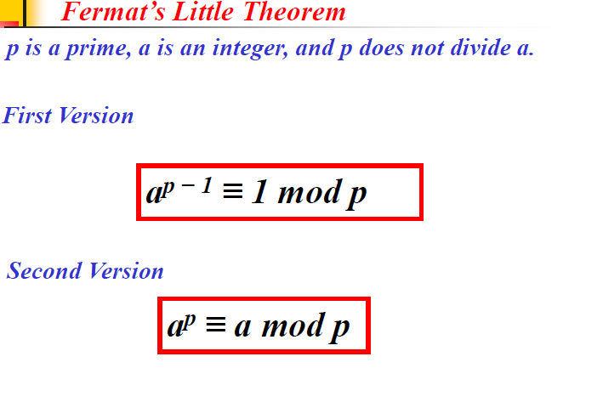
9.1.5 Fermat’s Little Theorem
First Version
a^{p − 1} ≡ 1 mod p
Second Version
a^{p} ≡ a mod p

Slide 80
9.1.5 Continued
Example 9.12
Find the result of 6¹⁰ mod 11.
Solution
We have 6¹⁰ mod 11 = 1. This is the first version of Fermat’s little theorem where p = 11.
Example 9.13
Find the result of 3¹² mod 11.
Solution
Here the exponent (12) and the modulus (11) are not the same. With substitution this can be solved using Fermat’s little theorem.

Slide 81
9.1.5 Continued
Multiplicative Inverses
a⁻¹ mod p = a ^{p − 2} mod p
Example 9.14
The answers to multiplicative inverses modulo a prime can be found without using the extended Euclidean algorithm:

Slide 82
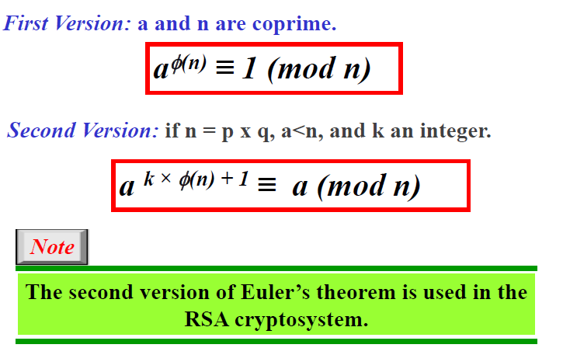
9.1.6 Euler’s Theorem
First Version
a^{φ(n)} ≡ 1 (mod n)
Second Version
a ^{k × φ(n) + 1} ≡ a (mod n)
Removes the condition that
a and n are co-prime
Note
The second version of Euler’s theorem is used in the RSA cryptosystem.

Slide 83
9.1.5 Continued
Example 9.15
Find the result of 6²⁴ mod 35.
Solution
We have 6²⁴ mod 35 = 6^{φ(35)} mod 35 = 1.
Example 9.16
Find the result of 20⁶² mod 77.
Solution
If we let k = 1 on the second version, we have
20⁶² mod 77 = (20 mod 77) (20^{φ(77)} ⁺ ¹ mod 77) mod 77
= (20)(20) mod 77 = 15.

Slide 84
9.1.6 Continued
Multiplicative Inverses
Euler’s theorem can be used to find multiplicative inverses modulo a composite.
a⁻¹ mod n = a^{φ(n)−1} mod n

Slide 85
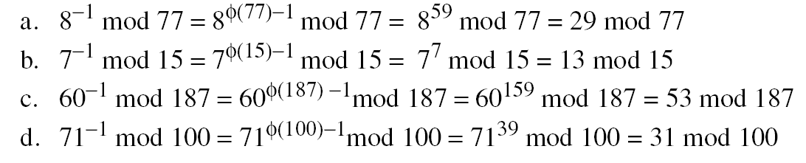
9.1.5 Continued
Example 9.17
The answers to multiplicative inverses modulo a composite can be found without using the extended Euclidean algorithm if we know the factorization of the composite:

Slide 86
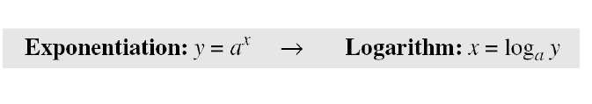
Exponentiation and Logarithm
In cryptography, common modular operation is exponentiation.
Often we need to calculate y = a^{x} mod n
RSA cryptosystem uses modular exponentiation for both encryption/decryption with very large exponents.
Adversary can use logarithm to attack. It is hard to reverse the exponentiation for larger modulus
Most computer have no operator to efficiently compute exponentiation and need for efficient algorithms

Slide 87
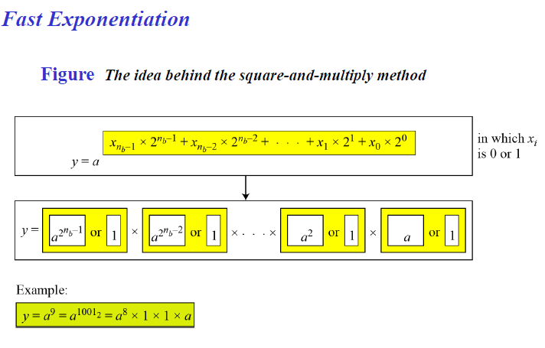
Unlike traditional algorithms which uses multiplication
Treat exponents as binary number of n_{b} bits.
y is product of n_{b} terms, square of bases if bit is 1.

Slide 88
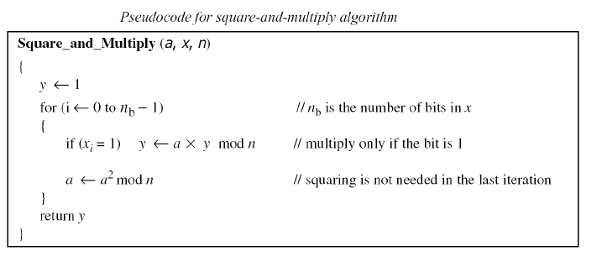
Value of bit is 1, multiples current base with previous value of result.
It then squares the base for the next iteration.

Slide 89
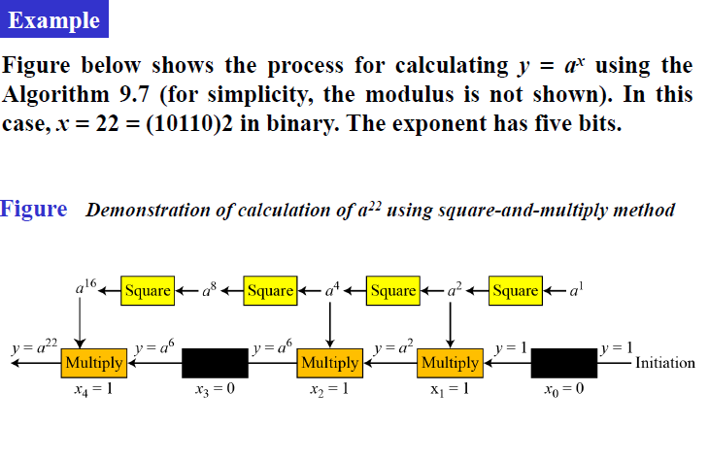
Value of y is gradually built until y=a²²

Slide 90
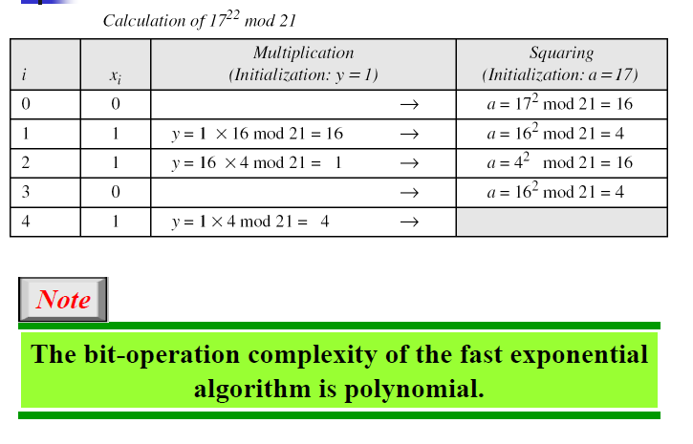
Bit operation complexity is O(n_{b}) as maximum of 2n_{b} arithmetic operations

Slide 91
9-4 CHINESE REMAINDER THEOREM
The Chinese remainder theorem (CRT) is used to solve a set of congruent equations with one variable but different moduli, which are relatively prime, as shown
below:

Slide 92
9-4 Continued
Example 9.35
The following is an example of a set of equations with different moduli:
The solution to this set of equations is given in the next section; for the moment, note that the answer to this set of equations is x =?

Slide 93
9-4 Continued
Solution To Chinese Remainder Theorem
1. Find M = m₁ × m₂ × … × m_{k}. This is the common modulus.
2. Find M₁ = M/m₁, M₂ = M/m₂, …, M_{k} = M/m_{k}.
3. Find the multiplicative inverse of M₁, M₂, …, M_{k} using the corresponding moduli (m₁, m₂, …, m_{k}). Call the inverses M₁⁻¹, M₂⁻¹, …, M_{k} ⁻¹.
4. The solution to the simultaneous equations is

Slide 94
9-4 Continued
Example 9.36
Find the solution to the simultaneous equations:
Solution We follow the four steps.
1. M = 3 × 5 × 7 = 105
2. M₁ = 105 / 3 = 35, M₂ = 105 / 5 = 21, M₃ = 105 / 7 = 15
3. The inverses are M₁⁻¹ = 2, M₂⁻¹ = 1, M₃ ⁻¹ = 1
4. x = (2 × 35 × 2 + 3 × 21 × 1 + 2 × 15 × 1) mod 105 = 23 mod 105

Slide 95
9-4 Continued
Example 9.35
The following is an example of a set of equations with different moduli:
The solution to this set of equations is given in the next section; for the moment, note that the answer to this set of equations is x = 23. This value satisfies all equations: 23 ≡ 2 (mod 3), 23 ≡ 3 (mod 5), and 23 ≡ 2 (mod 7).

Slide 96
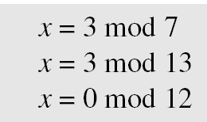
9-4 Continued
Example 9.37
Find an integer that has a remainder of 3 when divided by 7 and 13, but is divisible by 12.
Solution This is a CRT problem. We can form three equations and solve them to find the value of x.
If we follow the four steps, we find x = 276. We can check that 276 = 3 mod 7, 276 = 3 mod 13 and 276 is divisible by 12 (the quotient is 23 and the remainder is zero).

Slide 97
Mathematics of Cryptography Algebraic Structures
Copyright © The McGraw-Hill Companies, Inc. Permission required for reproduction or display.

Slide 98
Objectives
❏ To review the concept of algebraic structures
❏ To define and give some examples of groups
❏ To define and give some examples of rings
❏ To define and give some examples of fields
❏ To emphasize the finite fields of type GF(2^{n}) that make it possible to perform operations such as addition, subtraction, multiplication, and division on n-bit words in modern block ciphers

Slide 99
4-1 ALGEBRAIC STRUCTURES
Cryptography requires sets of integers and specific operations that are defined for those sets. The combination of the set and the operations that are applied to the elements of the set is called an algebraic structure. In this chapter, we will define three common algebraic structures: groups, rings, and fields.
Topics discussed in this section:
4.1.1 Groups 4.1.2 Rings 4.1.3 Fields

Slide 100
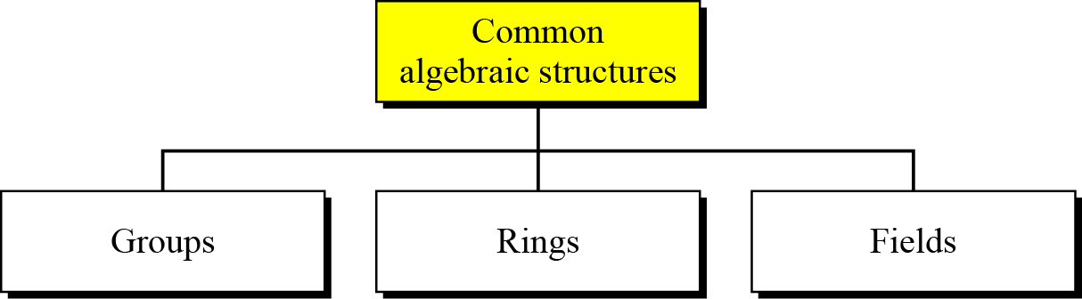
4.1 Continued
Figure 4.1 Common algebraic structure

Slide 101
4.1.1 Groups
A group (G) is a set of elements with a binary operation (•) that satisfies four properties (or axioms). A commutative group satisfies an extra property, commutativity:
❏ Closure:
❏ Associativity:
❏ Commutativity:
❏ Existence of identity:
❏ Existence of inverse:

Slide 102
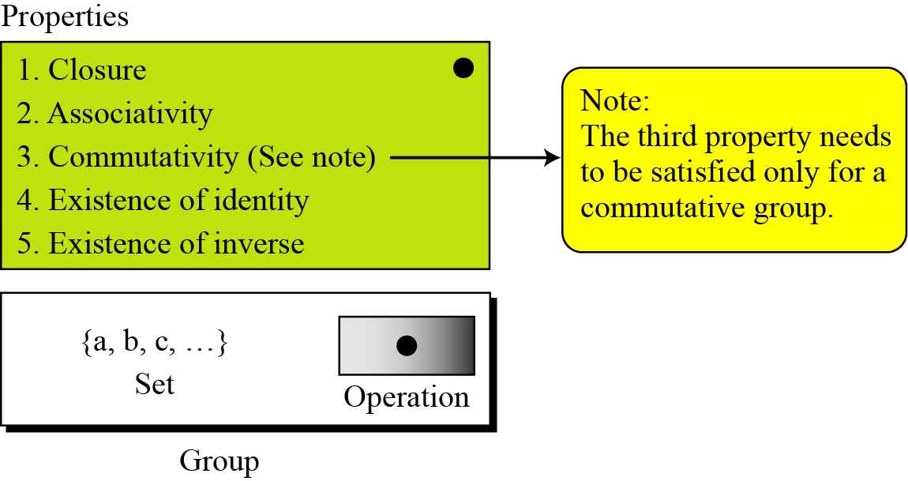
4.1.1 Continued
Figure 4.2 Group

Slide 103
4.1.1 Continued
Application
Although a group involves a single operation, the properties imposed on the operation allow the use of a pair of operations as long as they are inverses of each other.
Example 4.1
The set of residue integers with the addition operator,
G = < Z_{n} , +>,
is a commutative group. We can perform addition and subtraction on the elements of this set without moving out of the set.

Slide 104
4.1.1 Continued
Example 4.2
The set Z_{n}* with the multiplication operator, G = <Z_{n}*, ×>, is also an abelian group.

Slide 105
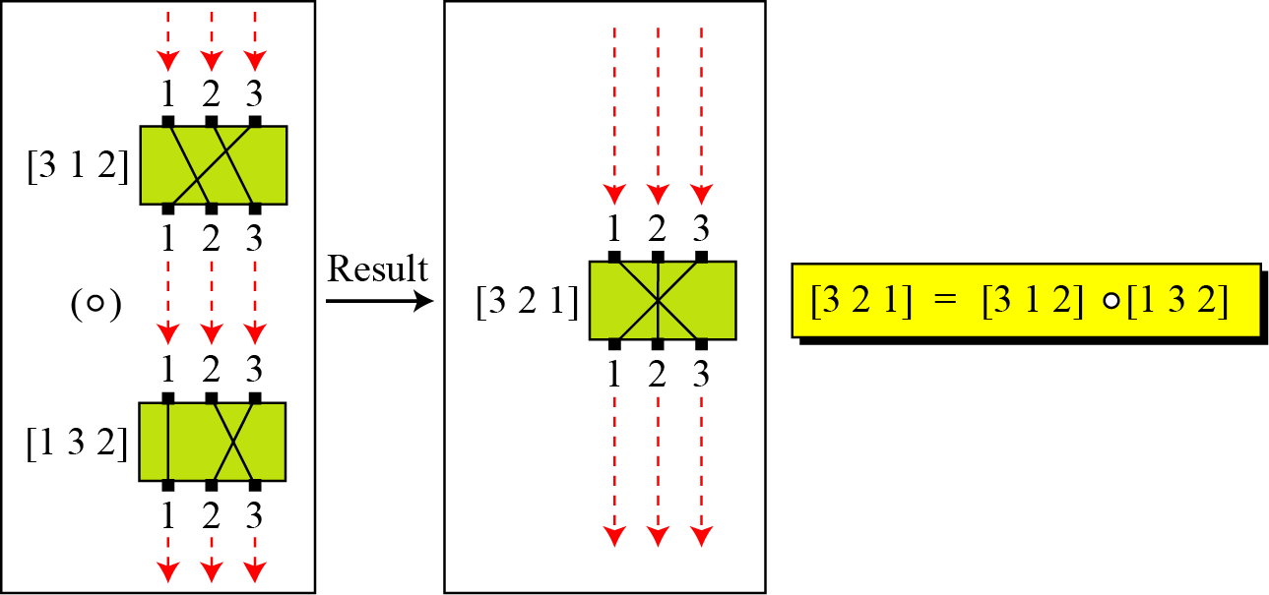
4.1.1 Continued
Example 4.4
A very interesting group is the permutation group. The set is the set of all permutations, and the operation is composition: applying one permutation after another.
Figure 4.3 Composition of permutation (Exercise 4.4)

Slide 106
4.1.1 Continued
Example 4.4
Continued
Table 4.2 Operation table for permutation group

Slide 107
4.1.1 Continued
Example 4.5
In the previous example, we showed that a set of permutations with the composition operation is a group. This implies that using two permutations one after another cannot strengthen the security
of a cipher, because we can always find a permutation that can do the same job because of the closure property.

Slide 108
4.1.1 Continued
Finite Group
Order of a Group
Subgroups

Slide 109
4.1.1 Continued
Example 4.6
Is the group H = <Z₁₀, +> a subgroup of the group G = <Z₁₂, +>?
Solution
The answer is no. Although H is a subset of G, the operations defined for these two groups are different. The operation in H is addition modulo 10; the operation in G is addition modulo 12.

Slide 110
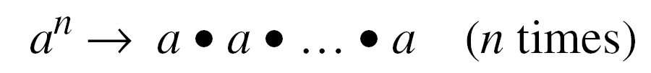
4.1.1 Continued
Cyclic Subgroups
If a subgroup of a group can be generated using the power of an element, the subgroup is called the cyclic subgroup.

Slide 111

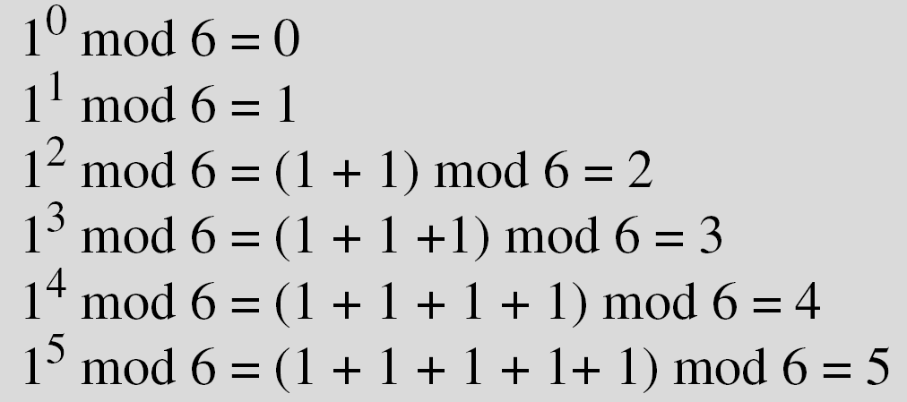
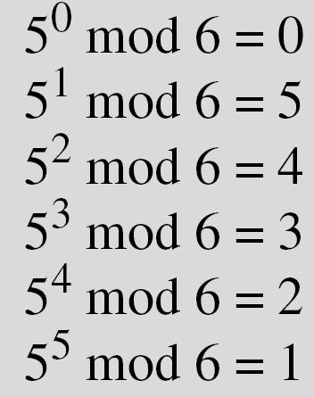
4.1.1 Continued
Example 4.7
Four cyclic subgroups can be made from the group G = <Z₆, +>. They are H₁ = <{0}, +>, H₂ = <{0, 2, 4}, +>, H₃ = <{0, 3}, +>, and H₄ = G.

Slide 112
4.1.1 Continued
Example 4.8
Three cyclic subgroups can be made from the group G = <Z₁₀∗, ×>. G has only four elements: 1, 3, 7, and 9. The cyclic subgroups are H₁ = <{1}, ×>, H₂ = <{1, 9}, ×>, and H₃ = G.

Slide 113
4.1.1 Continued
Cyclic Groups
A cyclic group is a group that is its own cyclic subgroup.

Slide 114
4.1.1 Continued
Example 4.9
Three cyclic subgroups can be made from the group G = <Z₁₀∗, ×>. G has only four elements: 1, 3, 7, and 9. The cyclic subgroups are H₁ = <{1}, ×>, H₂ = <{1, 9}, ×>, and H₃ = G.
a. The group G = <Z6, +> is a cyclic group with two generators, g = 1 and g = 5.
b. The group G = <Z10∗, ×> is a cyclic group with two generators, g = 3 and g = 7.

Slide 115
4.1.1 Continued
Lagrange’s Theorem
Assume that G is a group, and H is a subgroup of G. If the order of G and H are |G| and |H|, respectively, then, based on this theorem, |H| divides |G|.
Order of an Element
The order of an element is the order of the cyclic group it generates.

Slide 116
4.1.1 Continued
Example 4.10
a. In the group G = <Z₆, +>, the orders of the elements are: ord(0) = 1, ord(1) = 6, ord(2) = 3, ord(3) = 2, ord(4) = 3, ord(5) = 6.
b. In the group G = <Z₁₀*, ×>, the orders of the elements are: ord(1) = 1, ord(3) = 4, ord(7) = 4, ord(9) = 2.

Slide 117
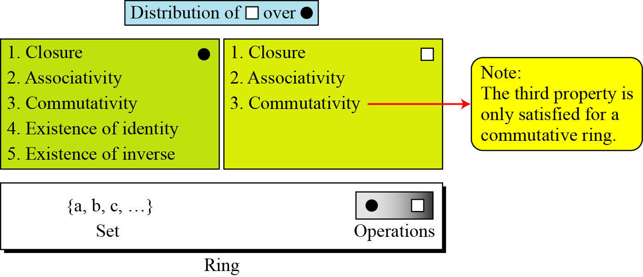
4.1.2 Ring
A ring, R = <{…}, •, >, is an algebraic structure with two operations.
Figure 4.4 Ring

Slide 118
4.1.2 Continued
Example 4.11
The set Z with two operations, addition and multiplication, is a commutative ring. We show it by R = <Z, +, ×>. Addition satisfies all of the five properties; multiplication satisfies only three properties.

Slide 119
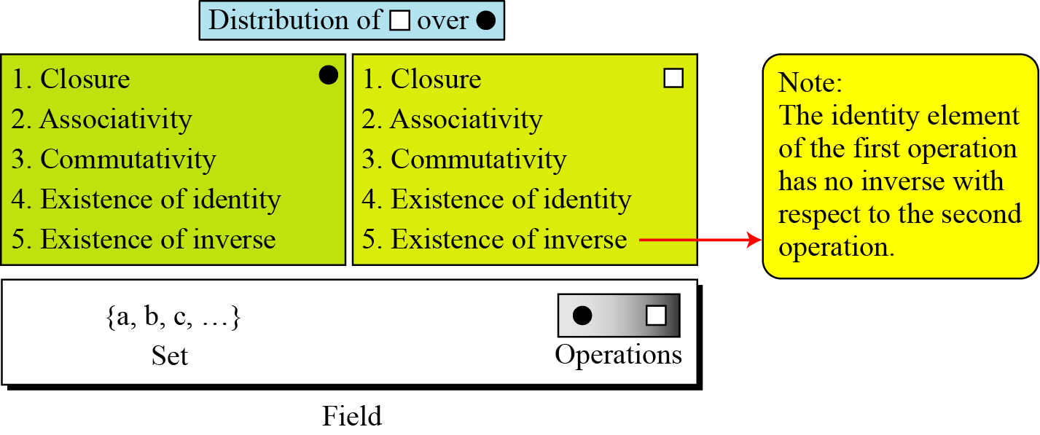
4.1.3 Field
A field, denoted by F = <{…}, •, > is a commutative ring in which the second operation satisfies all five properties defined for the first operation except that the identity of the first operation has no inverse.
Figure 4.5 Field

Slide 120
4.1.3 Continued
Finite Fields
Galois showed that for a field to be finite, the number of elements should be p^{n}, where p is a prime and n is a positive integer.
Note
A Galois field, GF(p^{n}), is a finite field with p^{n} elements.

Slide 121
4.1.3 Continued
GF(p) Fields
When n = 1, we have GF(p) field. This field can be the set Z_{p}, {0, 1, …, p − 1}, with two arithmetic operations.

Slide 122
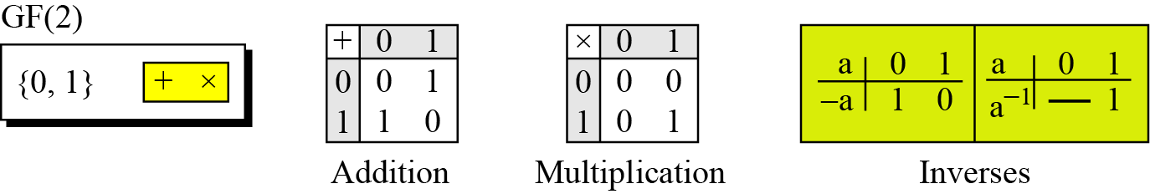
4.1.2 Continued
Example 4.12
A very common field in this category is GF(2) with the set {0, 1} and two operations, addition and multiplication, as shown in Figure 4.6.
Figure 4.6 GF(2) field

Slide 123
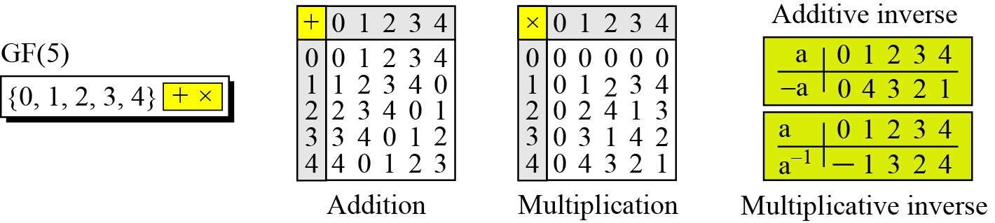
4.1.2 Continued
Example 4.13
We can define GF(5) on the set Z₅ (5 is a prime) with addition and multiplication operators as shown in Figure 4.7.
Figure 4.7 GF(5) field

Slide 124
4.1.3 Continued
Summary
Table 4.3 Summary

Slide 125
4-2 GF(2^{n}) FIELDS
In cryptography, we often need to use four operations (addition, subtraction, multiplication, and division). In other words, we need to use fields. We can work in GF(2^{n}) and uses a set of 2^{n} elements. The elements in this set are n-bit words.
Topics discussed in this section:
4.2.1 Polynomials 4.2.2 Using A Generator 4.2.3 Summary

Slide 126
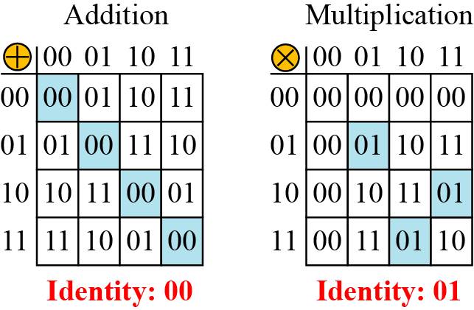
4.2 Continued
Example 4.14
Let us define a GF(2²) field in which the set has four 2-bit words: {00, 01, 10, 11}. We can redefine addition and multiplication for this field in such a way that all properties of these operations are satisfied, as shown in Figure 4.8.
Figure 4.8 An example of GF(2²) field

Slide 127
4.2.1 Polynomials
A polynomial of degree n − 1 is an expression
of the form
where x^{i} is called the ith term and a_{i} is called coefficient of the ith term.

Slide 128
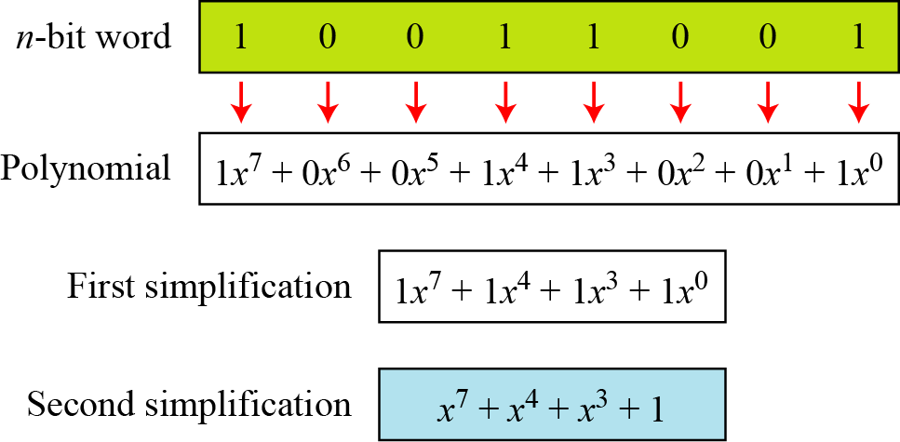
4.2.1 Continued
Example 4.15
Figure 4.9 show how we can represent the 8-bit word (10011001) using a polynomials.
Figure 4.9 Representation of an 8-bit word by a polynomial

Slide 129
4.2.1 Continued
Example 4.16
To find the 8-bit word related to the polynomial x⁵ + x² + x, we first supply the omitted terms. Since n = 8, it means the polynomial is of degree 7. The expanded polynomial is
This is related to the 8-bit word 00100110.

Slide 130
4.2.1 Continued
GF(2^{n}) Fields
Note
Polynomials representing n-bit words use two fields: GF(2) and GF(2^{n}).

Slide 131
4.2.1 Continued
Modulus
For the sets of polynomials in GF(2^{n}), a group of polynomials of degree n is defined as the modulus. Such polynomials are referred to as irreducible polynomials.
Table 4.9 List of irreducible polynomials

Slide 132
4.2.1 Continued
Addition
Note
Addition and subtraction operations on polynomials are the same operation.

Slide 133
4.2.1 Continued
Example 4.17
Let us do (x⁵ + x² + x) ⊕ (x³ + x² + 1) in GF(2⁸). We use the symbol ⊕ to show that we mean polynomial addition. The following shows the procedure:

Slide 134
4.2.1 Continued
Example 4.18
There is also another short cut. Because the addition in GF(2) means the exclusive-or (XOR) operation. So we can exclusive-or the two words, bits by bits, to get the result. In the previous example, x⁵ + x² + x is 00100110 and x³ + x² + 1 is 00001101. The result is 00101011 or in polynomial notation x⁵ + x³ + x + 1.

Slide 135
4.2.1 Continued
Multliplication
1. The coefficient multiplication is done in GF(2).
2. The multiplying x^{i} by x^{j} results in x^{i+j}.
3. The multiplication may create terms with degree more than n − 1, which means the result needs to be reduced using a modulus polynomial.

Slide 136
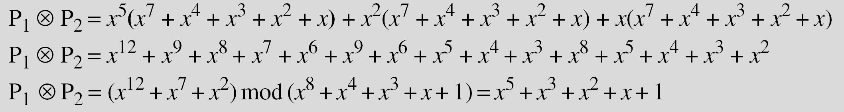
4.2.1 Continued
Example 4.19
Find the result of (x⁵ + x² + x) ⊗ (x⁷ + x⁴ + x³ + x² + x) in GF(2⁸) with irreducible polynomial (x⁸ + x⁴ + x³ + x + 1). Note that we use the symbol ⊗ to show the multiplication of two polynomials.
Solution
To find the final result, divide the polynomial of degree 12 by the polynomial of degree 8 (the modulus) and keep only the remainder. Figure 4.10 shows the process of division.

Slide 137
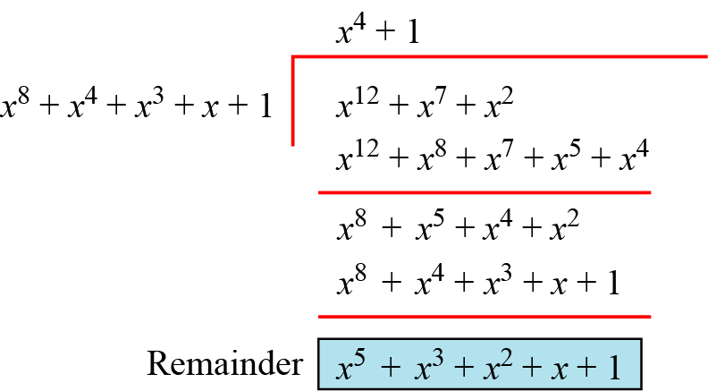
4.2.1 Continued
Figure 4.10 Polynomial division with coefficients in GF(2)

Slide 138

4.2.1 Continued
Example 4.20
In GF (2⁴), find the inverse of (x² + 1) modulo (x⁴ + x + 1).
Solution
The answer is (x³ + x + 1) as shown in Table 4.5.
Table 4.5 Euclidean algorithm for Exercise 4.20

Slide 139
4.2.1 Continued
Example 4.21
In GF(2⁸), find the inverse of (x⁵) modulo (x⁸ + x⁴ + x³ + x + 1).
Solution
The answer is (x⁵ + x⁴ + x³ + x) as shown in Table 4.6.
Table 4.6 Euclidean algorithm for Exercise 4.21

